Slide 1
Leveraging Natural Language Processing Techniques for Stock Price Prediction
Boyu Wu, B.Sc.
15.08.2024
Notes:
Topic
Quantitative trading strategies to predict stock movements honor working on this topic last couple monts
Got some nice results to make it up for you guys

Slide 2

Content
1
Motivation
2
Data Analysis and Methodology
3
Results
Notes:
Motivation > why we decided on the topic
DA and Meth
Every DS project one of the most important parts is the data sourcing and acquisition
Then also how we conducted our research
Results

Slide 3

Quantitative funds have seen a significant growth in assets under management, with a 10% CAGR – Trend underscores the increasing importance of data-driven investment strategies
1
Assets under management of hedge funds [billion USD]
“The emergence of quantitative trading […] represents a significant development trajectory in the fintech sector.”
Quantitative funds have seen a significant increase in assets under management – The 10% CAGR illustrates this growing interest
About 20% of hedge funds use quantitative strategies – 86% of hedge fund managers expect institutional investors to increase their allocations to quant strategies in the coming years
5,139
Raymond Lin, 2023
Chief Executive Officer of CLPS
4,798
4,844
CAGR +10%
3,826
3,194
2,906
2,878
2,219
2,367
1,884
2,025
1,367
1,403
1,408
1,482
2009
2010
2011
2012
2013
2014
2015
2016
2017
2018
2019
2020
2021
2022
2023
BarclayHedge (2024); Autochartist (2024)
Notes:
Motivation from 2 sides
Maasice increase in assets under management 10 % compound av.gr.rt. Last 15 years
About 20% of hedge funds already use quant trading strategies which includes NLP/sentiment analysis → if we assume an equal distribution of AUM 1 trillion USD
Amlost 90% of hedge funds managers expect an increase in quant strategies
CLPS IT service management company focused on banking and insurance mainly in china

Slide 4
Sentiment analysis is rapidly evolving, with major contributions from both academic research and practical implementations, especially in natural language processing and finance
1
How is this achived Same time technological advancement in NLP from … to … why and what is that?
Major Sentiment Analysis Milestones
Comment
Sentiment analysis has evolved from traditional algorithms to modern deep learning techniques
Transformer-based models like FinBERT are now used, particularly in financial data analysis
There has been continuous improvement in sentiment analysis methods, with more powerful hardware and larger datasets being used
Introduced text categorization with Support Vector Machines
Prove that lexicon based sentiment analysis can predict firms earnings
Introduce deep learning-based algorithms for Natural Language Processing
Introduced first FinBERT, a transformer-based architecture trained on financial news
Renni et al. (2003)
Milkolov et al. (2013)
Vaswani et al. (2017)
Hazourli (2022)
Joachims (1998)
Tetlock et al. (2008)
Conneau et al. (2016)
Araci (2019)
Establish Naïve Bayes Classifier as a viable alternative classification algorithm
Improve on lexicon-based analysis methods
Introduce transformer-based algorithms → considered one of the most important papers in the real of Artificial Intelligence
New Algorithms are constantly being developed trained on more and more data with more powerful hardware
Notes:
The second side is due to technological advancements. We show some of the mahor milestones here from traditional ML methods like SVm and NB
To lexicon based
To deep learning
To transformaer based LLM
Cinstantly new algorithms
Also application in the world of finance

Slide 5

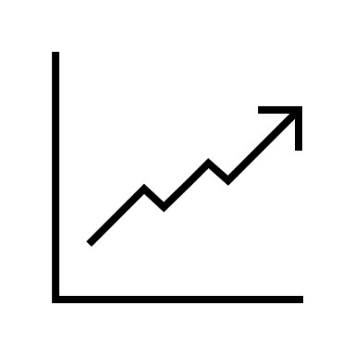







To evaluate sentiment algorithms and their impact on stock predictions, we aim to benchmark their performance and predict their real-world influence, requiring two datasets for analysis
1
1
Benchmarking of Sentiment Analysis Algorithms in Classifying Financial News
2
Predictions of Stock Movement Using Best Sentiment Algorithms
a
a
Benchmarking
Performance
Correlation Between Sentiment and Movement
b
b
Algorithm Strengths and Weaknesses
Testing Predictive Power
c
c
Comparison of Traditional vs. Advanced Models
Evaluation of Sentiment as a Trading Signal
Two datasets are needed:
One to benchmark algorithm accuracy and another to test the impact on sentiment trading strategies
Notes:
In our thesis 2 goals
Benchmarl of different algorithms for classifying financial news
… a,b,c
And then using said best algorithms to try to see whether there is a correlation between its predicted sentiment and stock movement
… b c

Slide 6
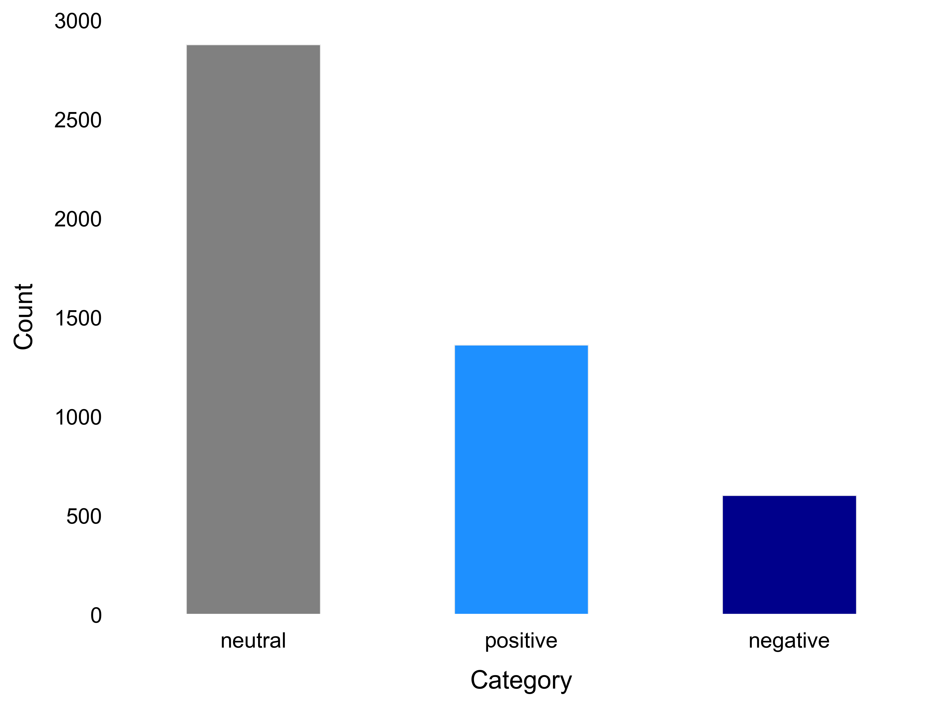
Sentiment analysis of labeled dataset reveals 59% neutral, 28% positive, and 13% negative sentiments – Highlighting the data imbalance of financial news
2
Benchmark
Distribution of Sentiment Categories in Financial News
Comment
Positive classified
Data is sourced from financial news articles and company press releases associated with entities listed on the OMX Helsinki exchange
The dataset includes a total of 4,846 news headlines analyzed – A total of 1,967 text exhibits a none neutral sentiment
A significant portion, totaling 2,879 headlines, is labeled as neutral, indicating an imbalance in the dataset
"Operating profit rose to EUR 13.1 mn from EUR 8.7 mn in the corresponding period in 2007 representing 7.7 % of net sales.”
Negative classified
"LONDON MarketWatch -- Share prices ended lower in London Monday as a rebound in bank stocks failed to offset broader weakness for the FTSE 100.”
Neutral classified
"Jacobs has been supporting Storengy's investment of developing storage sites since 2006 as owner 's engineer .“
Malo et al. (2014)
Notes:
Start with a look into the data set used
Used a dataset sourced from a paper from Malo in 2014
The almost 5k datapoints from OMX Helsinki exchange manually classified text from news and press releases by financial expert
Manually classification = clean data so no tidying was necessary here (we see a difference between the second data set)
Present % numbers → data imblanace important to look at different statistical metrics

Slide 7






Benchmarking sentiment analysis models using lexicon, machine learning, deep learning, and transformer-based approaches requires iterative tuning and evaluation through cross-validation
2
Benchmark
Model View
Process View
Dividing data into 5 stratified Folds
Train on 4 Folds, Validate on 1 Fold
Evaluate and Aggregate Performance
Select the Best Hyperparameters and Model
Model and Hyperparameter Selection
Lexicon
Uses predefined dictionaries of words with assigned sentiment values
VADER, SWN
Machine Learning
Use statistical models to classify sentiment
Methods require labeled training data
SVM, Logistic Regression, Naïve Bayes
XX%
Accuracy Score
Deep Learning
XX%
Employs neural networks to learn features from raw data
MLP, CNN
Macro Average F1-Score
Transformers
Utilizes transformer architectures for advanced sentiment analysis
BERT, GPT
Notes:
Process of benchmarking iteratively
4 buckets that we introduced in the beginning as different models that were using
Selecting these with repsected hyperparameters then conduct stratified k fold with 5 fold (short explain the circle)

Slide 8
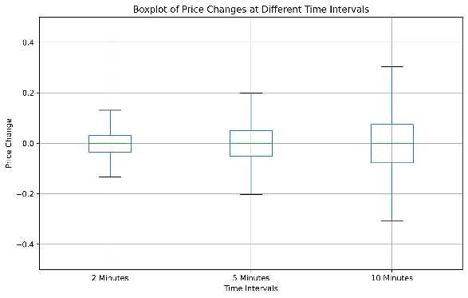
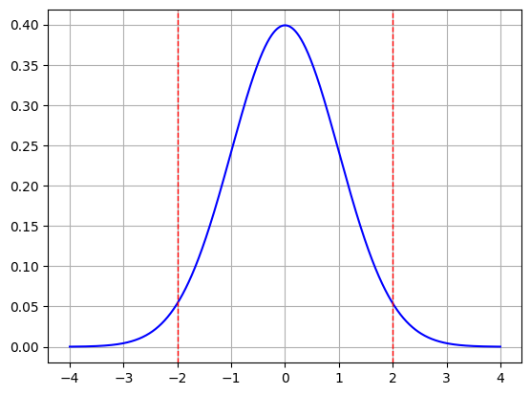

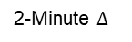








The process for analyzing stock news and price data involves sourcing, cleaning, and excluding outliers – We can observe that the percentiles are diverging over time
2
Request News and Stock Price
Handle Missing Data
Perform Data Cleaning
Data
Prediction
Query Refinitiv Datastream API for financial news articles and stock price
Filter the news articles to focus on relevant companies and time periods
Identify gaps in the dataset where stock price data or news articles are missing
Use backward filling techniques to estimate missing stock prices
Remove duplicates from the dataset to avoid skewing the analysis
Exclude outliers in stock price movements using statistical methods
25th Percentile
75th Percentile
VADER
2-Minute $∆$
$$−0.034\%$$
$$0.032\%$$
5-Minute $∆$
$$−0.0515\%$$
$$0.0491\%$$
10-Minute $∆$
$$−0.0778\%$$
$0.0743$%
EURO STOXX 50
Notes:
On the other side we have the real life news data:
Requires maticules cleaning effords and extraction
Select EUROSTOXX 50 Reporting standards and availability of English news
Merge two datasets both sourced from REF – Financial news articles and stock prices → merge these on time published
Missing data via backfilling and perform other data cleaning efforts
Outlier analysis and duplicates removing filter out closing time data …. Uniform data type …
In total we want to then have a dataset with the news/news headline on one row and the change in stock prices in the other (since research suggest only a correlation short time after news publication correlation between movement and sentiment (looked at 2,5,10 minutes)
>As expected median near 0 however with lager standard deviation over time
> We observe diverging of the percentiles over time here. More spread is more possibility of utilizing this spread
Align Stock Price Data with News Timestamps
Match each news article with the closest stock price data point based on its publication time
Ensure all timestamps are synchronized to account for time zone differences
Filter out data corresponding to periods of market closures, where no trading occurred

Slide 9


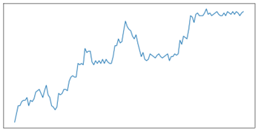
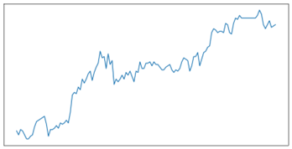
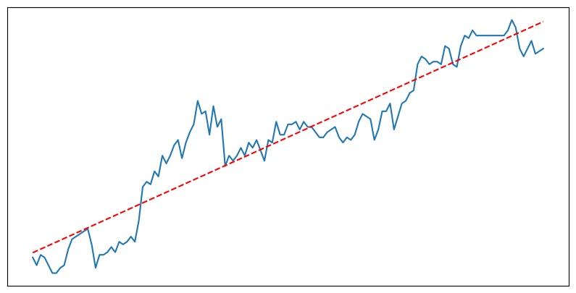
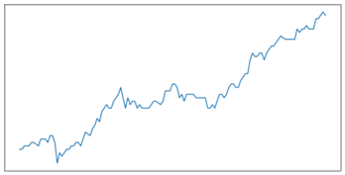
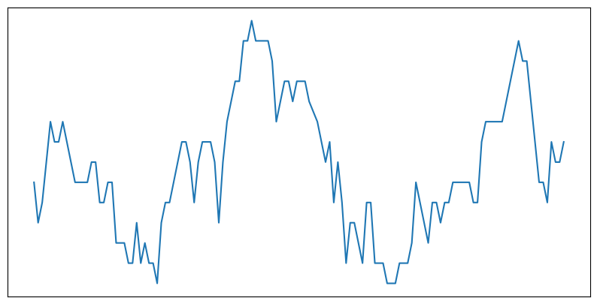
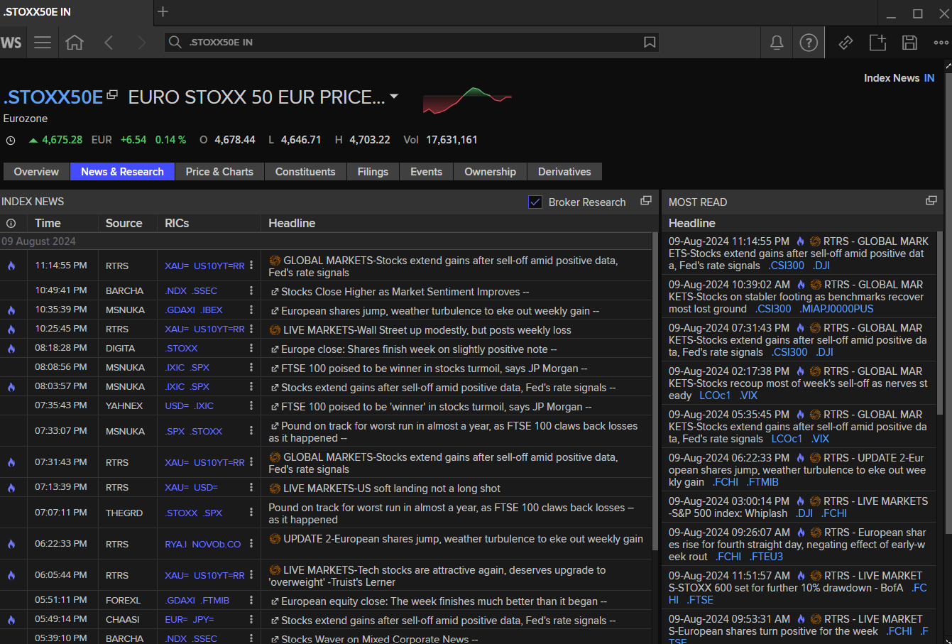
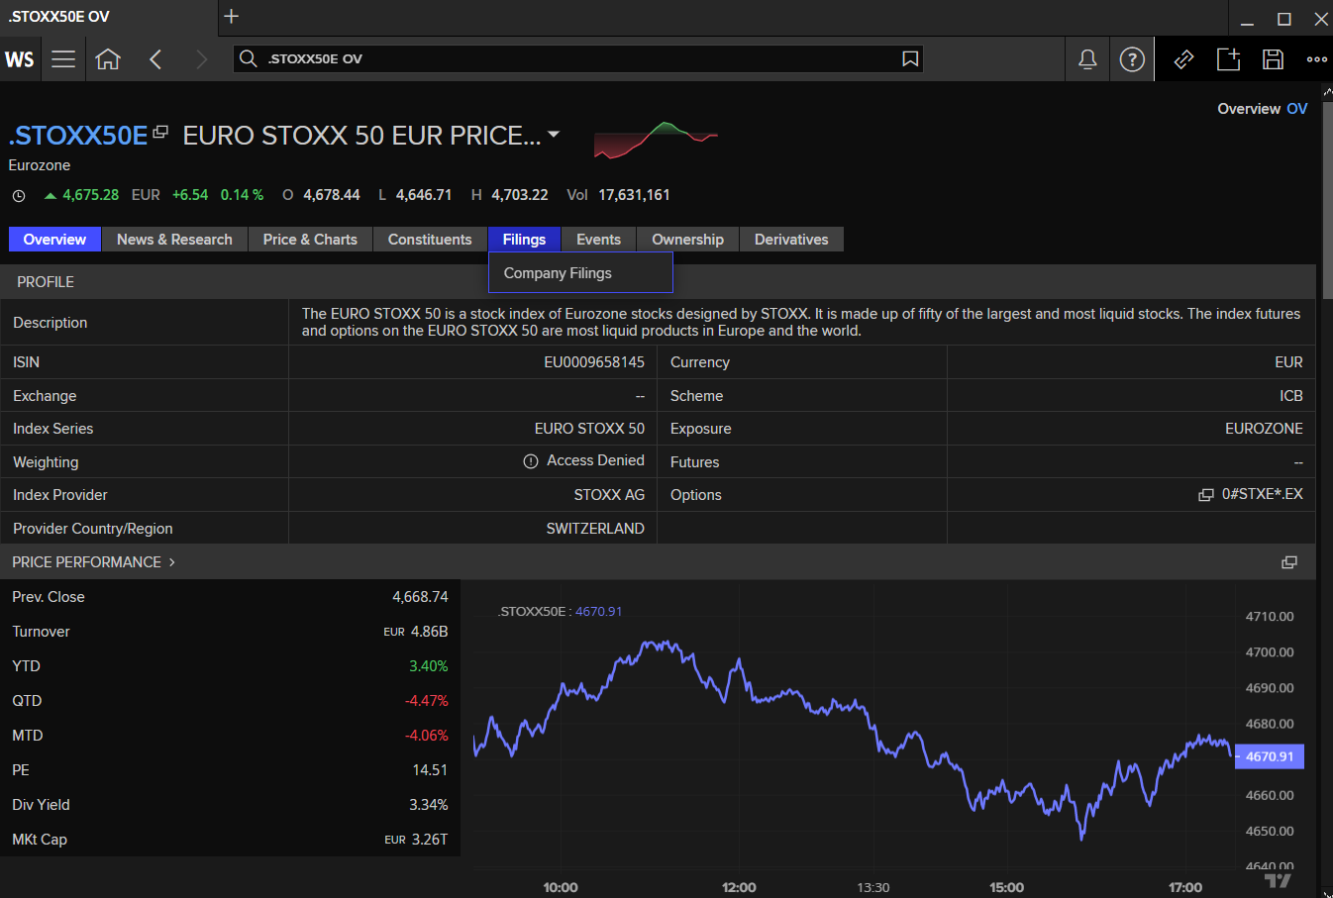
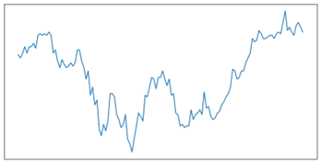
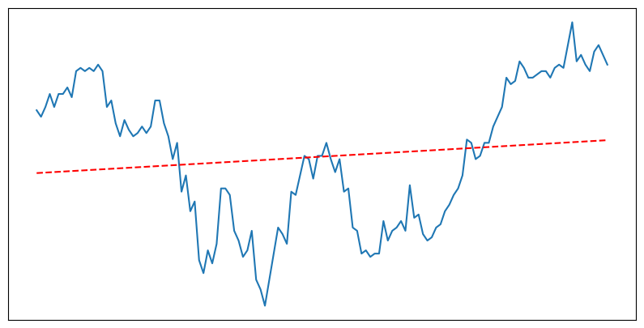
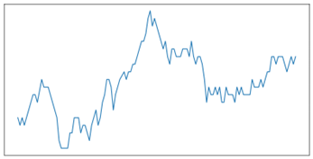
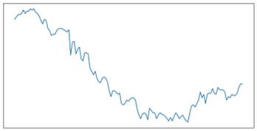
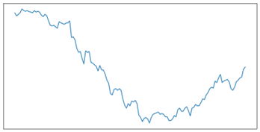
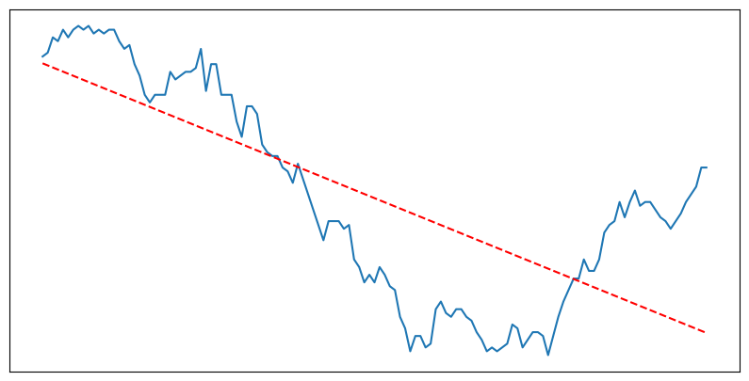
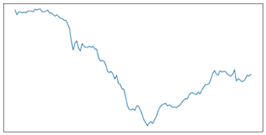
Stock market data is classified using sentiment analysis tools like VADER, SVM, and FinBERT, and these classifications are used in regression models to predict stock prices
2
Prediction
Data
Classification
Regression
106,854
4
positive
Data Points
Algorithms
VADER
SVM
neutral
MLP
Financial
BERT
The classified sentiment data is used in linear regression model to predict stock prices, identifying potential upward or downward trends
Sentiment analysis tools classify stock market data into positive, neutral, or negative categories
negative
EURO STOXX 50
Notes:
Use the data 100000 datapoints to conduct a linear regression
Here we ise the best algorithms in each of the 4 buckets
These best algorithms we wll use the tuned hyperparameters form the precious section as well
> Classify into pos neu neg and then depending on this classification do a regression model

Slide 10
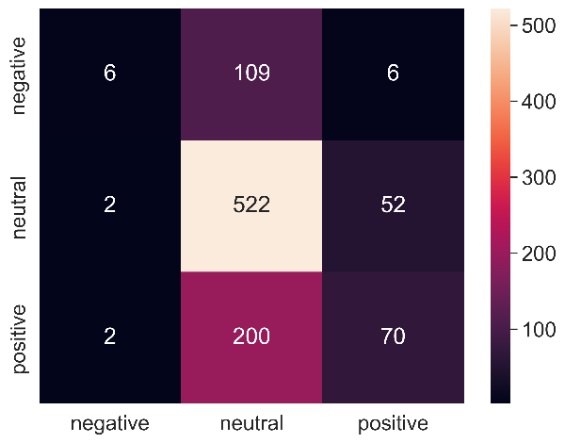
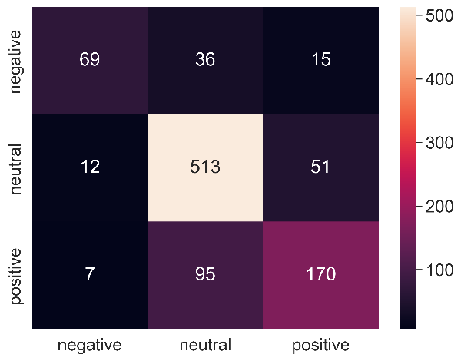
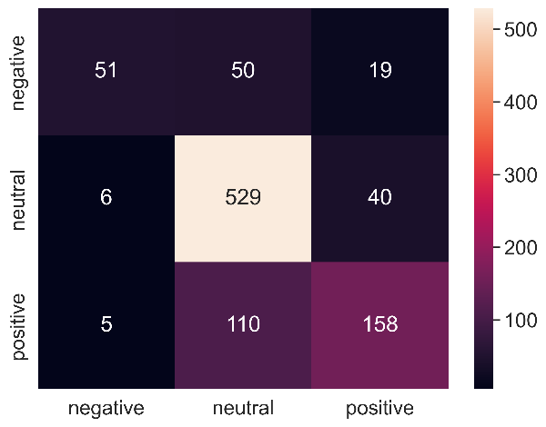
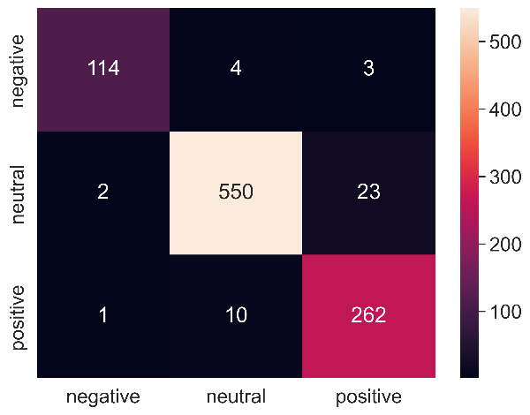
FinBERT outperforms other models in financial sentiment analysis, demonstrating the highest accuracy and macro average F1-score – both with a score of 95%
3
Benchmark
Vader
SVM
MLP
FinBERT
62%
78%
77%
95%
Accuracy Score
Accuracy Score
Accuracy Score
Accuracy Score
39%
72%
71%
95%
Macro Average F1-Score
Macro Average F1-Score
Macro Average F1-Score
Macro Average F1-Score
Macro average F1-score balances precision and recall, providing a more comprehensive evaluation of model performance than accuracy alone
Notes:
But lets jump into the most interesting part the results here I want to focus some more time;
Here are the results for the best in each bucket
Lexicon based, Traditional ML, Deep Learning, Transformer

Slide 11










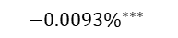






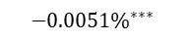




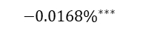




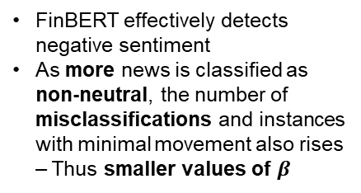

All algorithms can predict negative stock movement with statistically significance – OLS reveals SVM and FinBERT perform best, accurately classifying many articles as non-negative
3
Prediction
$$f\left(x\right)=β_{0}+ β_{1} \text{Sentiment}\text{_}\text{Neg} + β_{2} \text{Sentiment}\text{_}\text{Pos} + ε$$
Vader
SVM
VADER often misclassifies news as neutral due to its rule-based approach – missing subtle sentiment cues
Effectively identifies negative sentiment linked to stock drops but struggles with detecting positive sentiment
SVM effectively predicts stock decreases with negative news and hints at a correct direction for positive sentiment
Performance issues can stem from the small training data set, affecting the reliability of its sentiment classifications
VADER
$$β$$
Count
VADER
$$β$$
Count
Intercept
$$−0.0011\%$$
$$99527$$
Intercept
$$−0.0002\%$$
$$78308$$
Sentiment_Neg
$${−0.0168\%}^{∗∗∗}$$
$$990$$
Sentiment_Neg
$${−0.0093\%}^{∗∗∗}$$
$$9604$$
Sentiment_Pos
$$+0.0053\%$$
$$6067$$
Sentiment_Pos
$$+0.0004\%$$
$$18672$$
MLP
FinBERT
MLP struggles with performance due to limited data, highlighting the need for more data in deep learning compared to traditional methods like SVM
Only a small amount of negative classified text
FinBERT effectively detects negative sentiment
As more news is classified as non-neutral, the number of misclassifications and instances with minimal movement also rises – Thus smaller values of $β$
MLP
$$β$$
Count
VADER
$$β$$
Count
Intercept
$$−0.0008\%$$
$$100064$$
Intercept
$$+0.0006\%$$
$$44348$$
Sentiment_Neg
$${−0.0265\%}^{∗}$$
$$174$$
Sentiment_Neg
$${−0.0051\%}^{∗∗∗}$$
$$27195$$
Sentiment_Pos
$$−0.0014\%$$
$$6346$$
Sentiment_Pos
$−0.0008$%
$$35041$$
*** 1% significance, ** 5% significance, *10% significance- level
Notes:
The results for our realtime dataset:
Explain the fomular
Betas are the relative change compared to a neutral news 0 both = neutral
Explain count (count for each classified bucket)

Slide 12
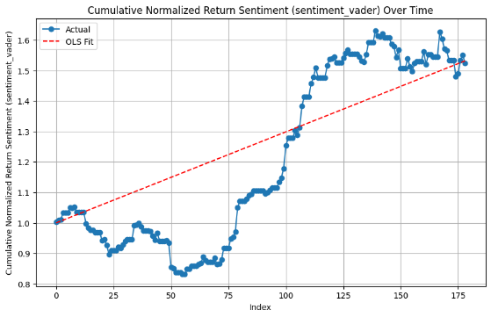
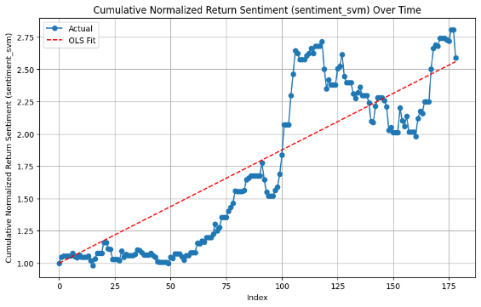
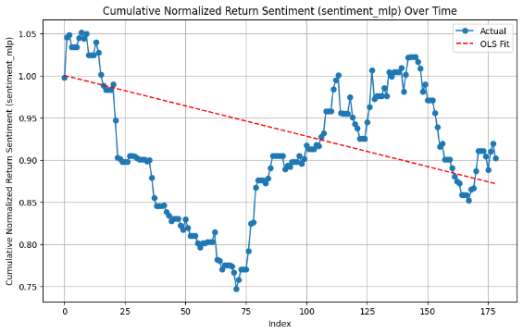
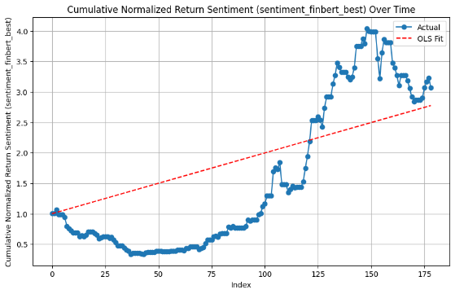


SVM has the best risk-adjusted and stable return, while FinBERT offers the highest overall expected growth potential per day - MLP with negative performance
3
Prediction
Vader
SVM
MLP
FinBERT
1.48
1.88
-0.47
1.47
Sharpe Ratio
Sharpe Ratio
Sharpe Ratio
Sharpe Ratio
0.3%
0.88%
-0.07%
1%
Expected Returns per day
Expected Returns per day
Expected Returns per day
Expected Returns per day
The Sharpe ratio helps investors evaluate the risk-adjusted return of an investment by comparing its excess return over a risk-free rate to its volatility – Crucial for portfolio optimization
11 von 14
Notes:
From these results we also wanted to try out a simple trading strategy so utilize sentiment for buy and sell signals
Positive sentiment buy news sell after 10 minutes
Negative sentiment I short and buy back after 10 minutes
For evaluating strategies 2 key KPIs here Sharpe ratio – risk vs reward the higher the ratio the less risk for the reward it is (risk free rate 4%)
And ofcourse the expected retrns we use a per day basis here
MLP bad apart from that all of them super good and beat the euroStoxx index its sharpe ratio around 0.8 and returns 0.1%
SVM and Finbert worth pointing out
SVM: 156% return over 6 months FinBERT: 178% return over the same time span (-66.4% return at one point High Risk)

Slide 13

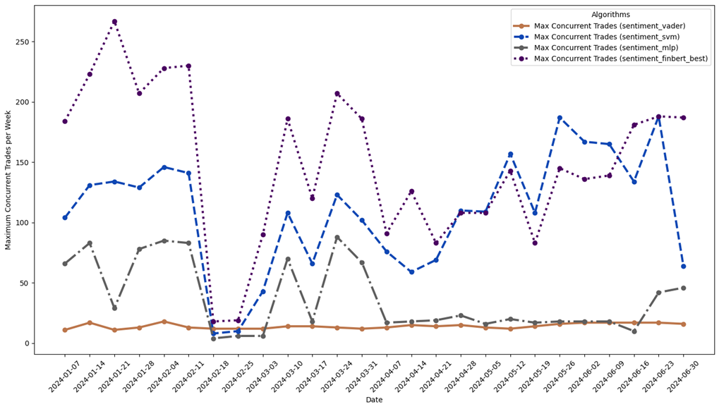
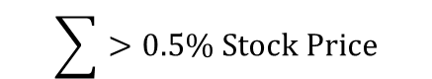
Sentiment-based trading comes with significant risks, such as transaction costs – Frequent trading can erode profits and external factors impact effectiveness of these strategies
3
Prediction
Many trades are conducted in parallel, with FinBERT consistently trading over 200 stocks simultaneously.
In some weeks, it only trades a few stocks at a time, leading to significant fluctuations in investment activity
High trading frequency trading erodes profits through transaction costs
Some Trading Fees to Consider:
Maximum Weekly Trade Volume Across Algorithms
$$\sum{>0.5\% \text{Stock} \text{Price}}$$
Trade Commissions
Bid-Ask Spread
Currency Exchange Fees…
12 von 14
Notes:
Wow these results are insane!!! Can I just drop out now and not submit my thesis but instead build my own company and trade stocks full time?
NOOOOO!!!!!! Very high risk associated with it AND we didn’t consider Trading Fees which erode all our profits. Especially since we are consistently trading 200 stocks at a given time (for finbert e.g.) each trade cost money!!
Some cost to consider trade commusiions ro bropkerage fees, bid ask spread… currency exchange fees …. Amount up more than 0.5% of stock price
We remember we if we predict a sentiment it is associated with a price change of 0.01% so each of our trade has less returns than the 0.5% of stpck price.
So sadly with this thesis I wont be able to drop out and become a millionair :(

Slide 14



Next Steps…
Incorporate additional data sources
I
Current Scope: Extracting only six months’ worth of data and selecting news exclusively through Refinitiv – An extension would involve incorporating web-based news sources as well
Training Data: Increasing the number of training data points would be advantageous
Algorithmic optimization
II
Optimizing Hyperparameters: Fine-tuning the hyperparameters can significantly enhance model performance – Better Hyperparameter optimization approaches can be used
Advanced Models: Experimenting with more advanced models such as FinLlama or GPT-4 can further improve results
Improve treading strategy
III
Current Strategy: Very simple, only considering sentiment. To improve, add technical indicators such as historical stock prices and integrate them into the strategy as well
Buy and Sell Signals: Incorporate more sophisticated buy and sell signals. Applying the algorithm in the real world can help validate its effectiveness
Notes:
BUT MAYBE IF WE CONTINUE WE MIGHT BE ABLE TO IMPROVE ON OUR ALGORITHMS AND THEN EARN A PROFIT:
Incorporate additional data sources
More data – Refinitiv eikon also offers web based news (as a quick win) Else web scraping, social media news,…
Algoritms – More advanced state of the art algorithms GPT, FinLLama → improve hyperparameter tuning process
Better trading strats: Add technical indicators and historical prices to consider as well → more sophisticated buy and sell signals and ofc validate in real word with real money huhuhuhu

Slide 15
14 von 14

